Slide 1

Hotel Review Classification
Team Members
N.Shirisha
Swati Deokar
B.Sathwik Reddy
B.Mahalakshmi
P.Syam Gopal
M.Anitha
S.Srinivas Reddy

Slide 2
About Us
Hotel reviews offer essential insights for any hotel business, as most future customers depend on peer feedback when choosing their stay.
In this study, we analyze hotel reviews by focusing on the ratings and feedback provided in the review text to understand customer opinions better.

Slide 3
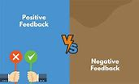

Business Objective
The hotel dataset includes 20,490 reviews and 1 feedback. The goal is to analyze how travelers express their experiences online, focusing on both positive and negative aspects. By identifying key attributes that influence hotel selection, managers can better understand which elements drive positive reviews and enhance the hotel's brand image.
Text Review Feedback

Slide 4
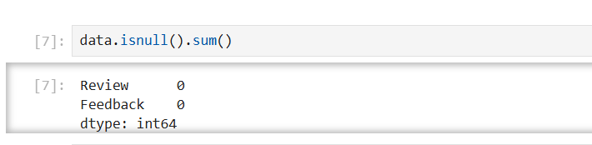
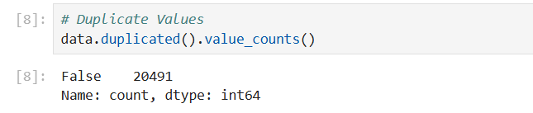
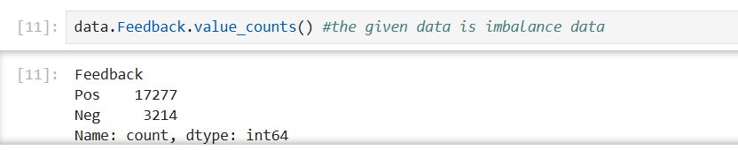
Exploratory Data Analysis
Checking Null Values Checking Duplicated values
Checking Value_Counts

Slide 5
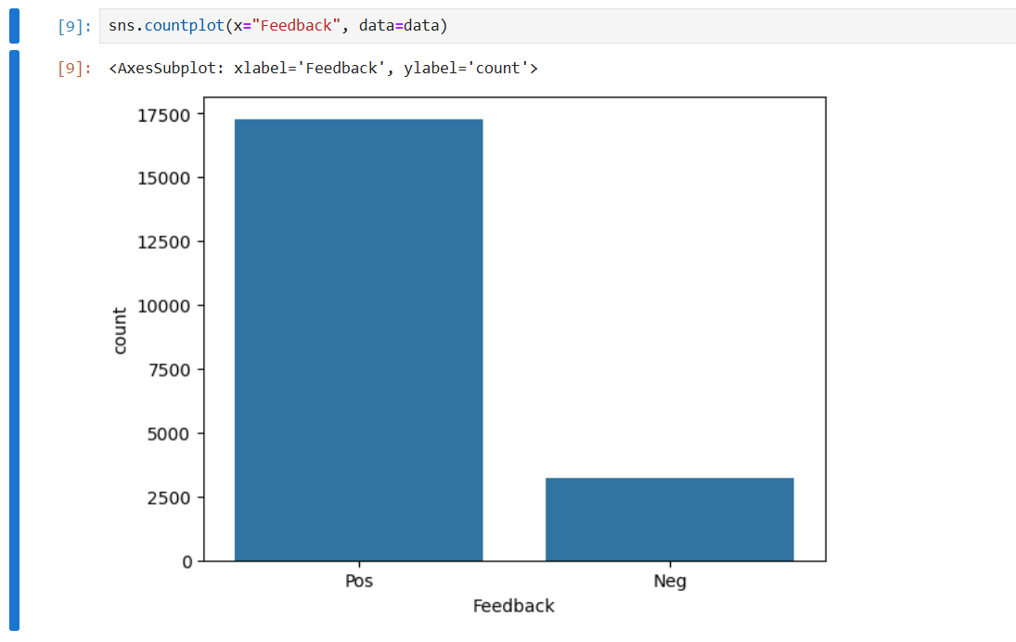
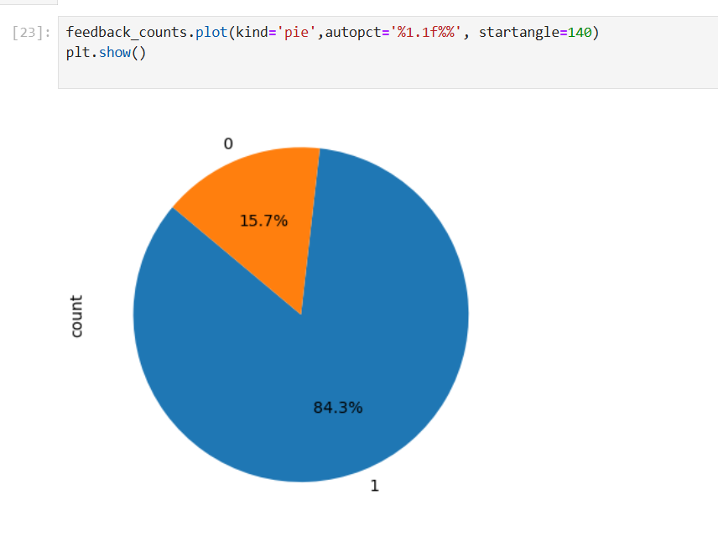
Visual Insights from Hotel Reviews
Pie graph
Countplot

Slide 6
Text Preprocessing Methodology
Steps Involved:
Convert to Lowercase:
Ensure uniformity by converting all text to lowercase
2.Remove Punctuation and Numbers:
Strip out any punctuation marks and numbers to focus on meaningful words.
3.Tokenization:
Break down the text into individual words (tokens) for better processing.
4.Stopwords Removal and Lemmatization:
Eliminate common stopwords (e.g., 'the', 'and') that don't add value.
Apply lemmatization to reduce words to their base form (e.g., 'running' to 'run').

Slide 7
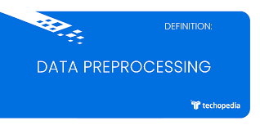
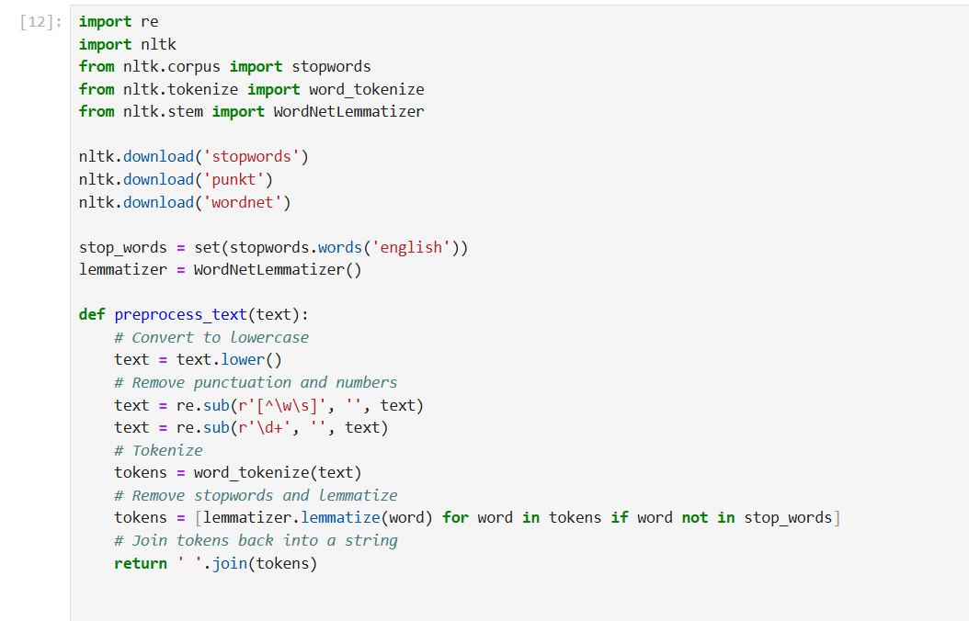
STEPS FOR DATA CLEANING
Remove Punctuation
Case change
Tokenization
Removing stop words

Slide 8
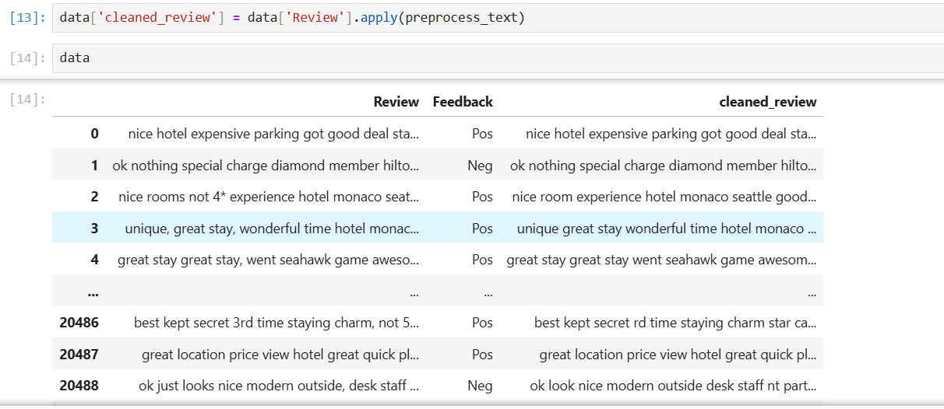
Before and After Analysis

Slide 9

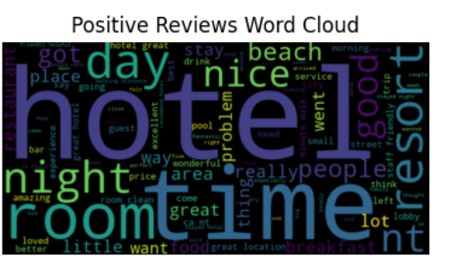
Word Cloud: Positive Reviews

Slide 10
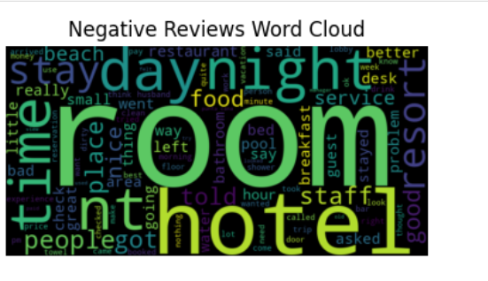
Word Cloud: Negative Reviews

Slide 11
Feature extraction Using TFIDF
Feature extraction for machine learning and deep learning. Feature extraction refers to the process of transforming raw data into numerical features that can be processed while preserving the information in the original data set. It yields better results than applying machine learning directly to the raw data.
The concept TF-IDF stands for term frequency-inverse document frequency. This is in the field of numerical statistics. With this concept, we will be able to decide how important a word is to a given document in the present dataset or corpus.

Slide 12
Term Frequency with TFIDF
Term Frequency-Inverse Document Frequency
1.TF-IDF Vectorization:
TF-IDF (Term Frequency-Inverse Document Frequency):
Measures the importance of words in a document relative to a corpus.
Parameters Used:
max_features=5000: Limit to the top 5000 most frequent terms.
min_df=5: Exclude terms that occur in fewer than 5 documents.
max_df=0.7: Exclude terms that appear in more than 70% of the documents.
2.Transformation:
Data: data['cleaned_review']
Output Array: X (Features)
Labels: y (0 for Negative, 1 for Positive)

Slide 13
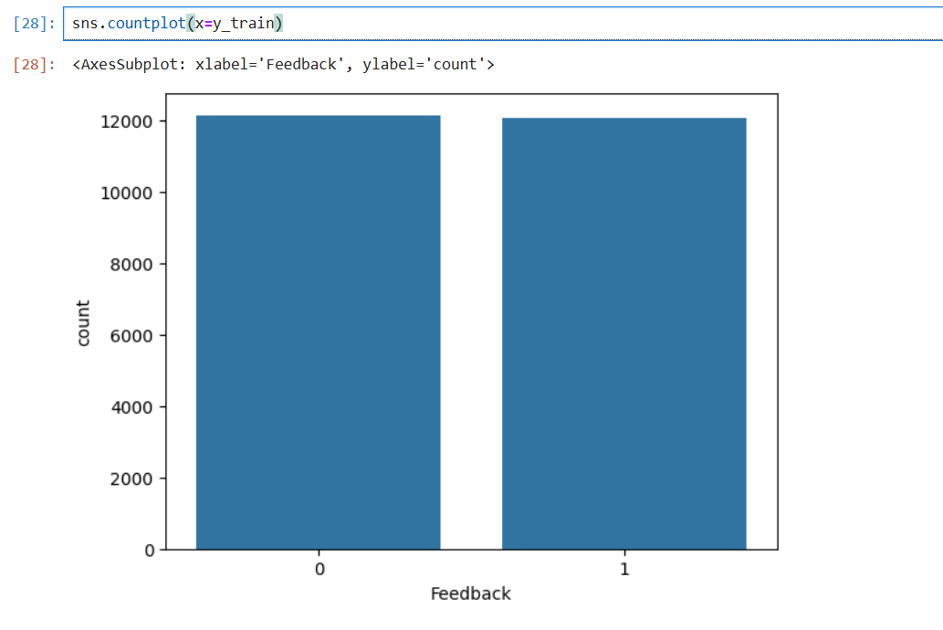

Sampling Distribution of Feedback Classes
The count plot illustrates the distribution of positive and negative feedback classes in the training dataset. This visualization helps assess the balance between classes and ensure representative sampling for model training.

Slide 14
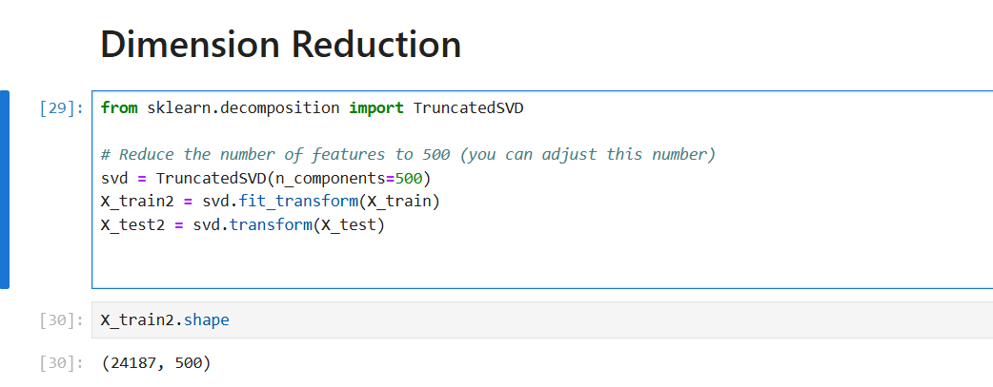
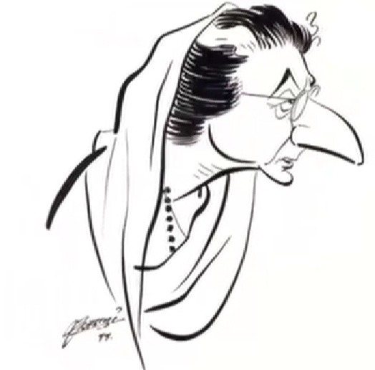
Dimensionality Reduction Using TruncatedSVD
Applied TruncatedSVD to reduce feature dimensions to 500, enhancing computational efficiency and model performance.

Slide 15
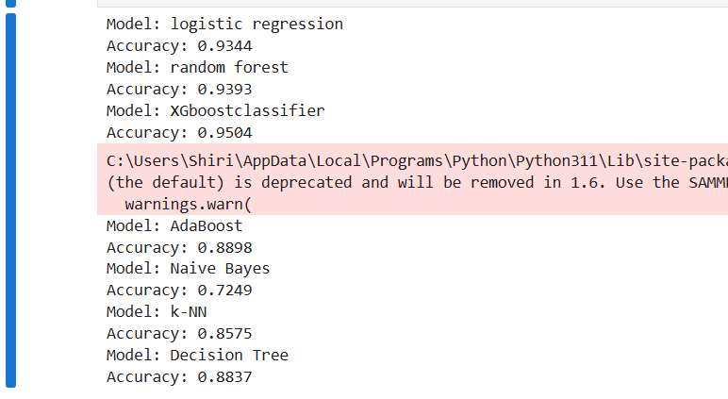
Model Building
Logistic Regression
RandomForestClassifier
AdaBoostClassifier
GaussianNB
KNeighborsClassifier
DecisionTreeClassifier
XGBClassifier

Slide 16
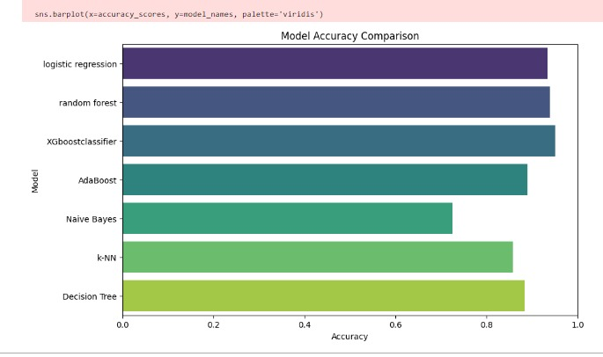
Model Accuracy Comparision

Slide 17
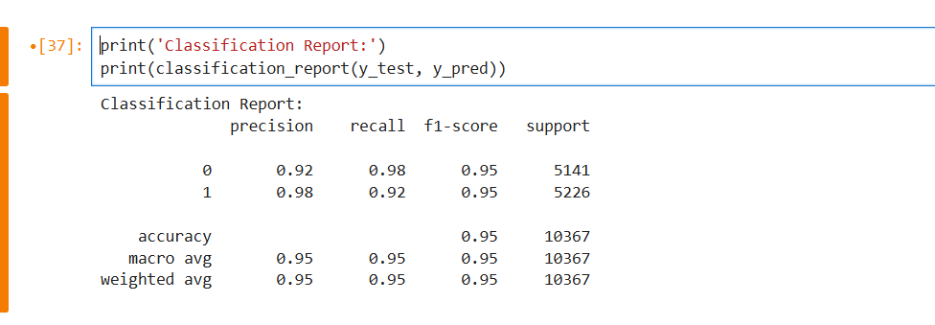
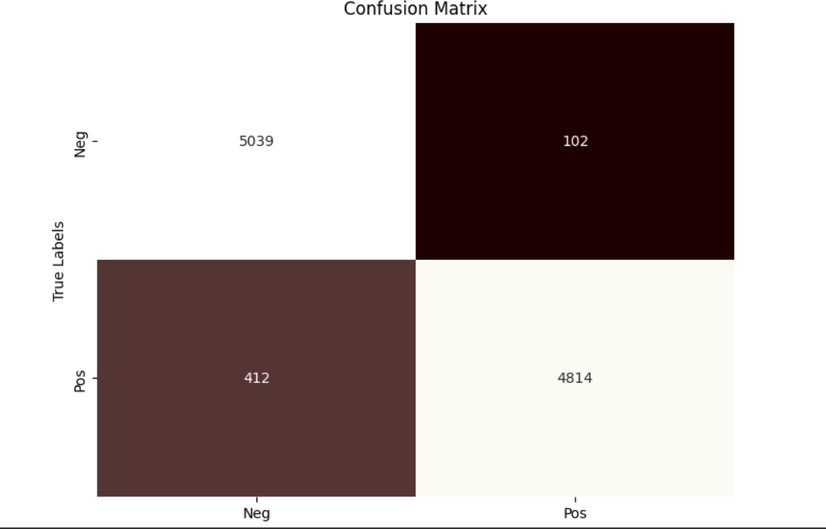
Final Model - XGBoost Classifier
The XGBoost classifier was successfully trained on the reduced feature set, achieving an impressive accuracy of 99%. This high-performance model is now ready for deployment, providing robust predictions based on the refined dataset.

Slide 18
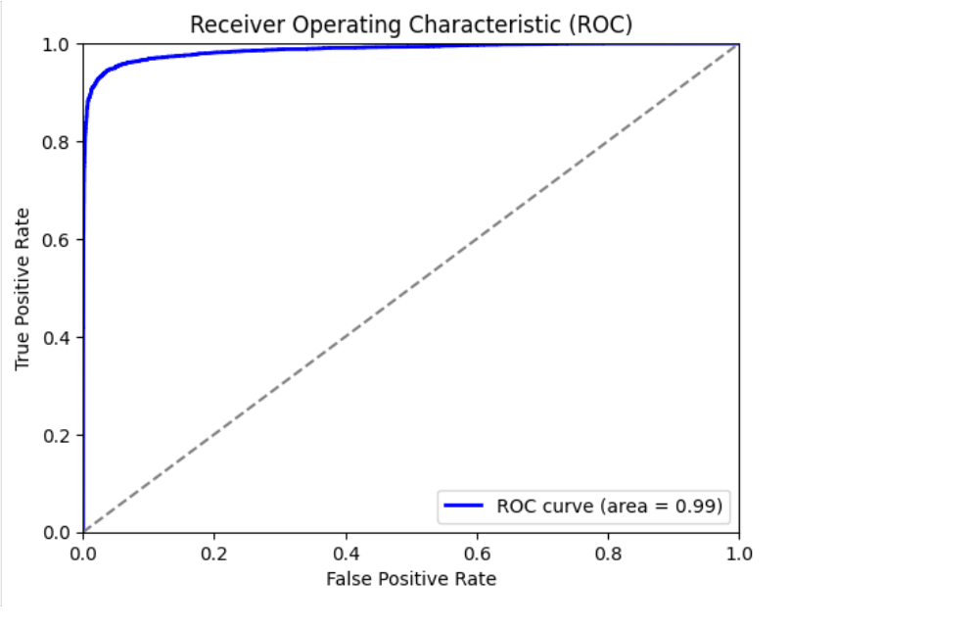
Model Testing…
ROC PLOT
Performance of XGBoost Classifier
Accuracy 99%

Slide 19
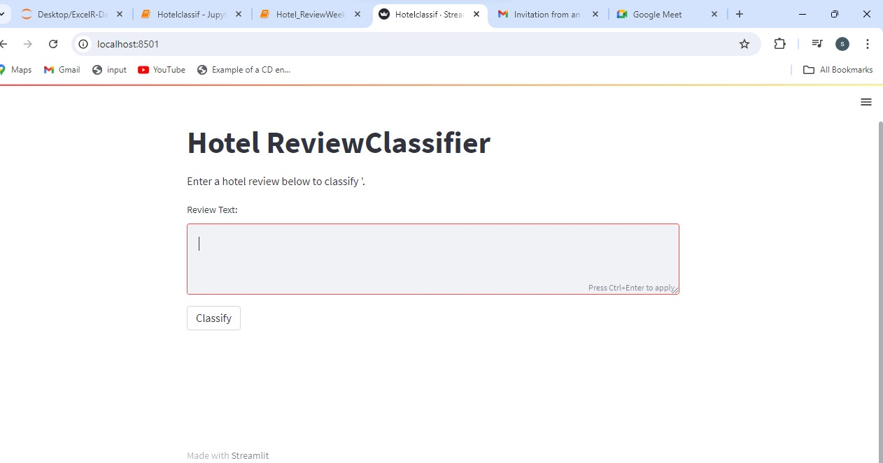
Deployment
Deployment is the process of making a software application or machine learning model available for use by users in a real-world environment.

Slide 20
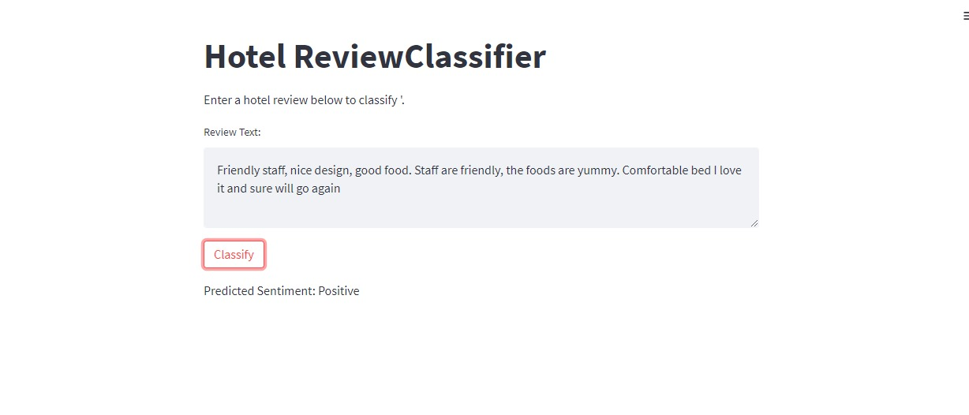
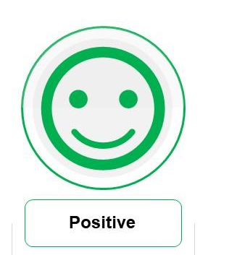
Positive Review

Slide 21
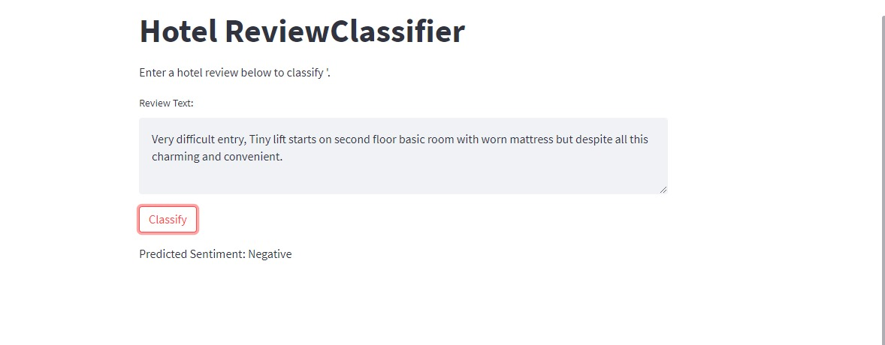
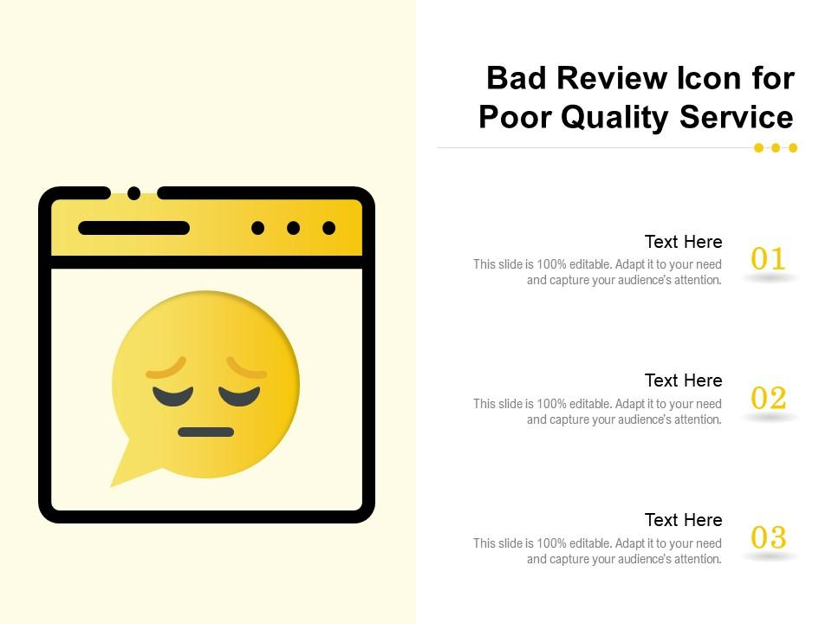
Negative Review

Slide 22
Challenges
1. Data Quality: Handling noisy and unstructured text data required extensive preprocessing to ensure meaningful analysis.
2. Imbalanced Classes: Managing class imbalance in the feedback labels was crucial to avoid biased model performance.
3. Feature Selection: Reducing high-dimensional feature space while retaining essential information posed a significant challenge.
4. Model Complexity: Fine-tuning the XGBoost classifier to achieve high accuracy involved careful parameter optimization and computational resources.

Slide 23
Conclusion:
This NLP project effectively analyzed hotel reviews, transforming text data into valuable insights. The XGBoost classifier, optimized through careful preprocessing and feature selection, achieved 99% accuracy. The final model aids in understanding customer sentiments, offering actionable predictions to enhance hotel services.

Slide 24


